Slide 1
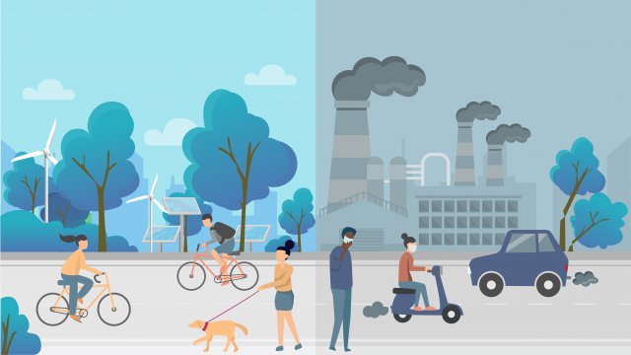
Air Quality
Hannah van der Zanden, Laura van Lierop, Maud Spierings & Yara van de bersselaar

Slide 2
Table of contents
Interview
Co2 emission
Interview
Greenhouse gases
The netherlands compered to other country’s

Slide 3
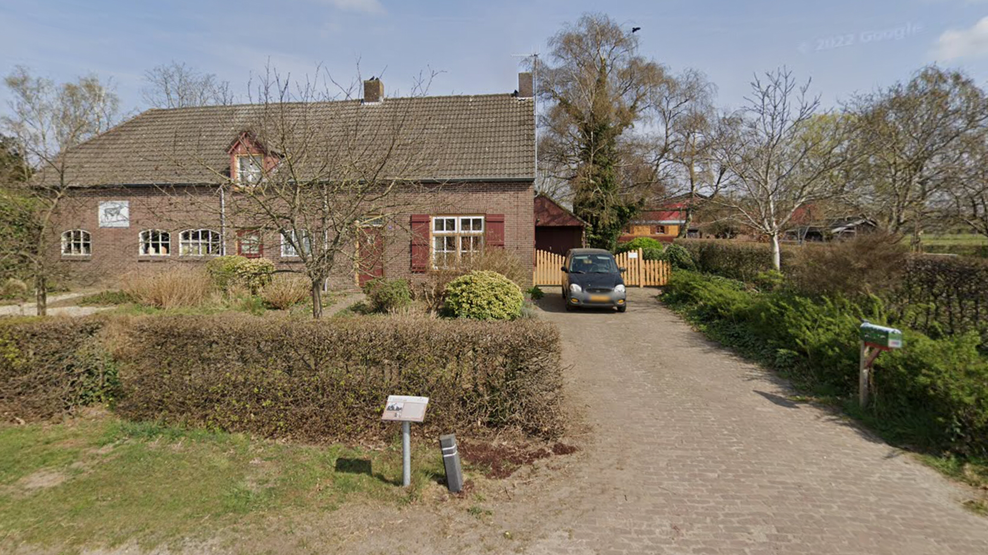
Interview farmer
Hanneke verb
OWN company
90 dairy cattle
Educational company
2 guesthouses
Day care

Slide 4
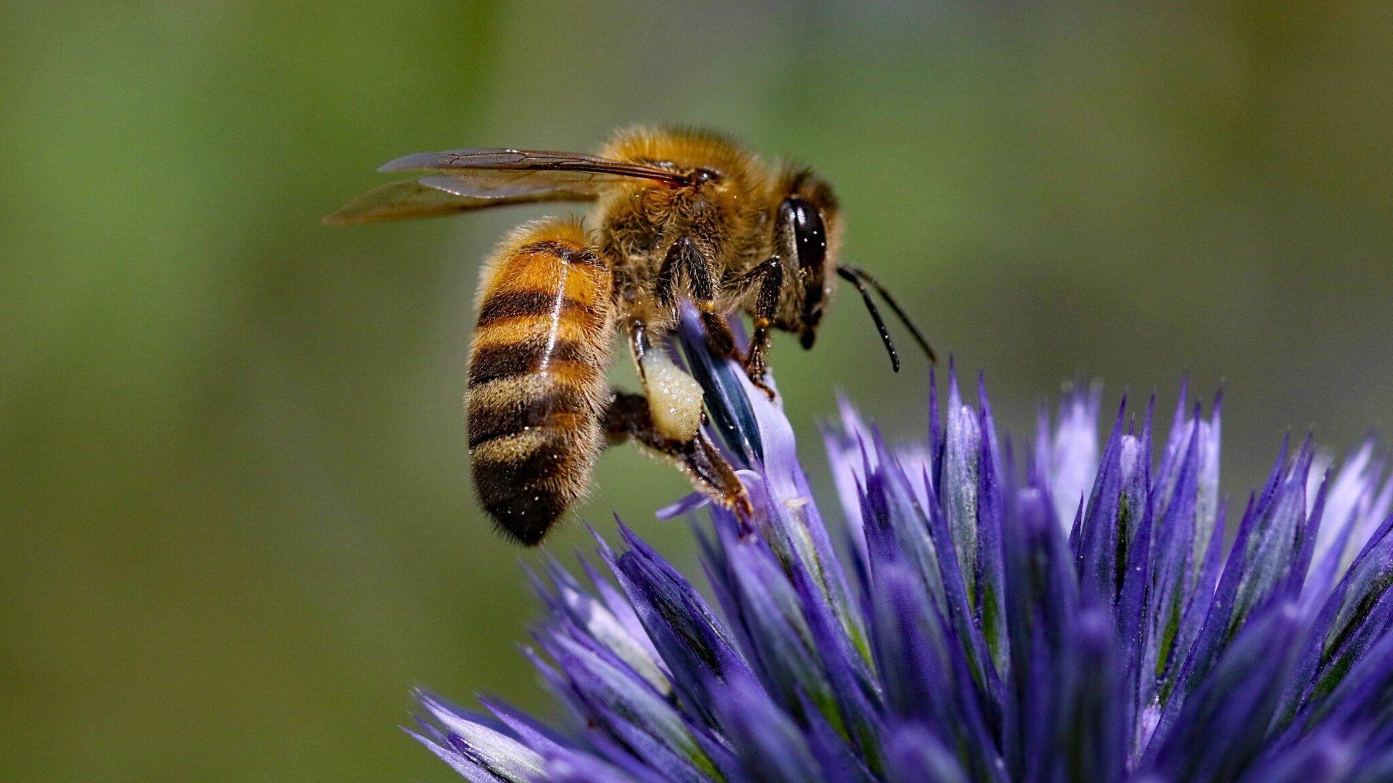
What did she do to get the N2 down?
1. Green label Floor
- 40% last ammonia
2. 1 km hedges
- biodiversity
Attract bees
80%
Sponge

Slide 5
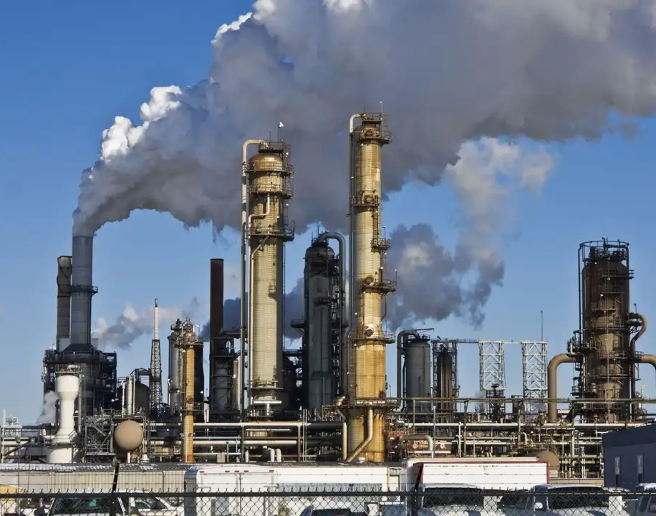
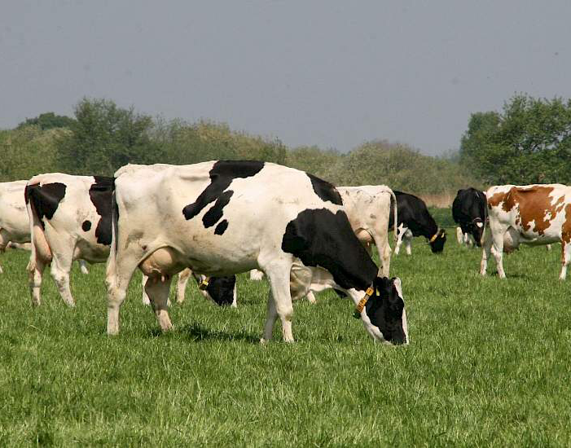
Do you think that the most co2 emission comes through the farmers or the industrie?
Environment permit
Ruhr area
Blown our way
Farmers are blamed
More transport (1963)

Slide 6
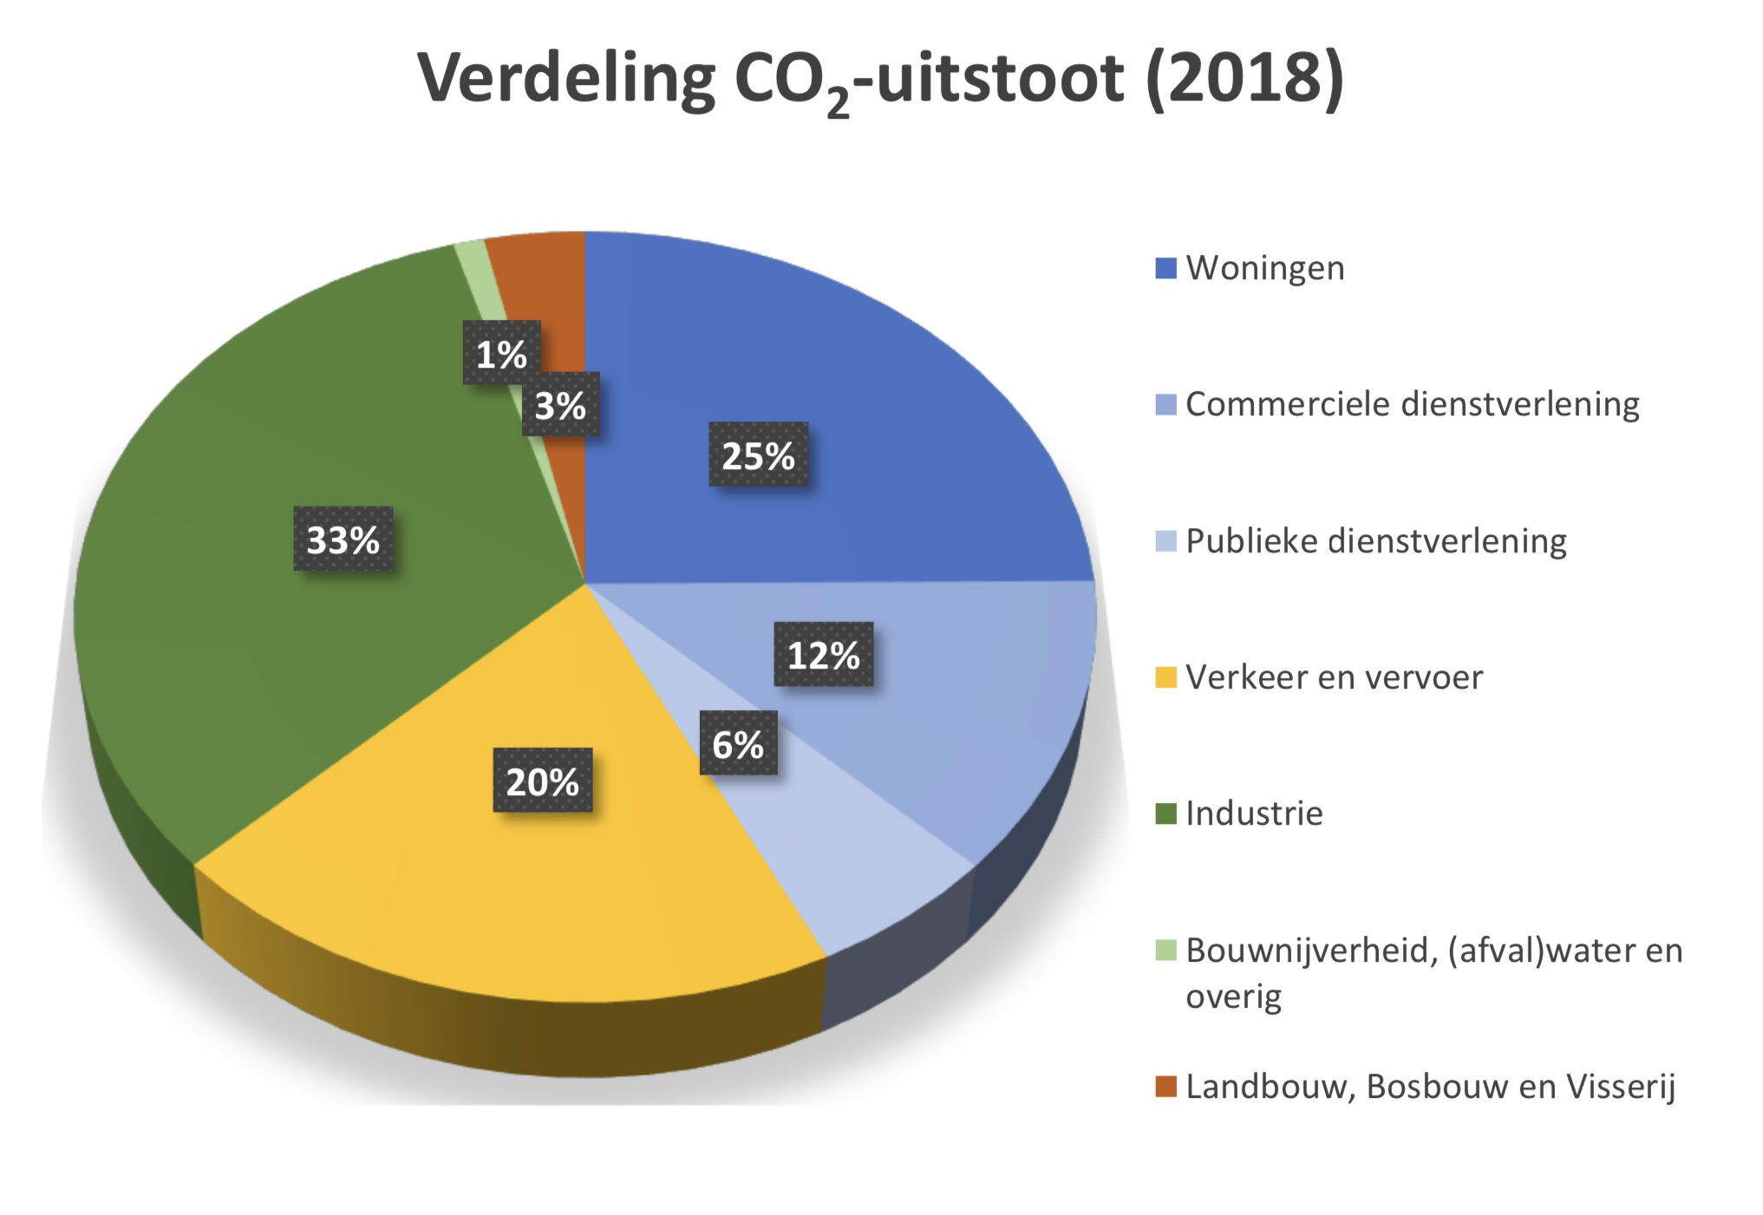
CO2 emission
Industrie
- the most
Transport
- solution interview
Farmers
- weird
- interview

Slide 7
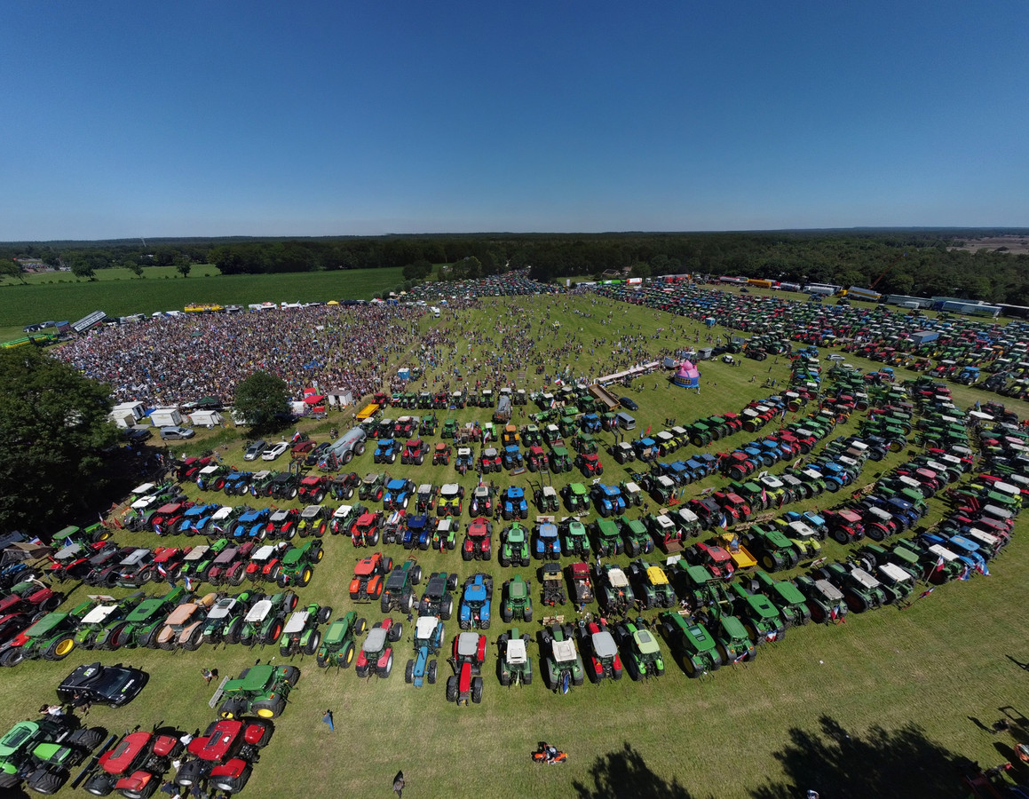
Do you went to the stroe protest?
Yes, they protest
See the picture

Slide 8
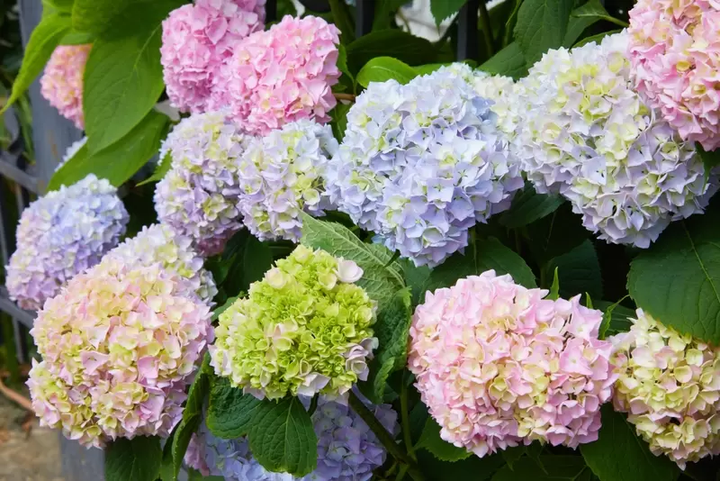
What is a possible solution?
Expansive air traffic
Hedges plant

Slide 9
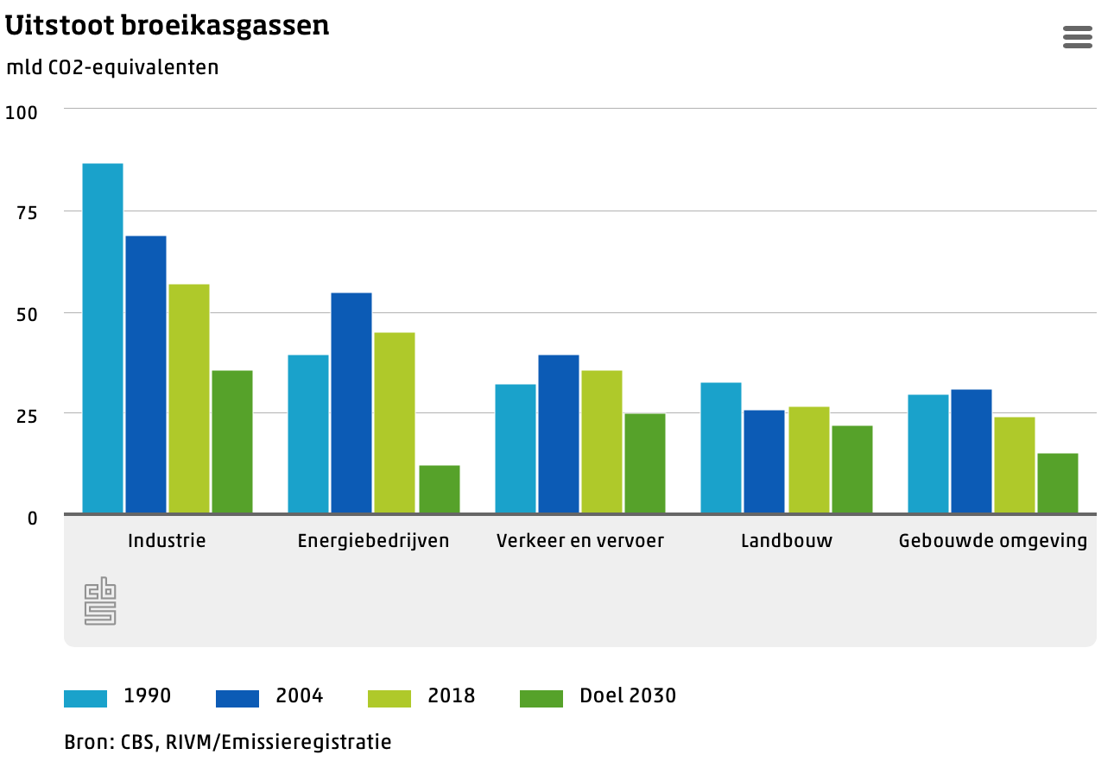
Greenhouse gases
Emission
Industrie
- big progress
Energie company’s
- no progress
Transport
- almost no progress
Building
- almost no progress

Slide 10
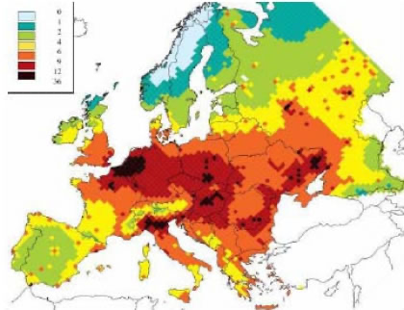
The Netherlands compered to europa
Netherlands had baddest emission
You can see your own country compered to the rest

